Slide 1
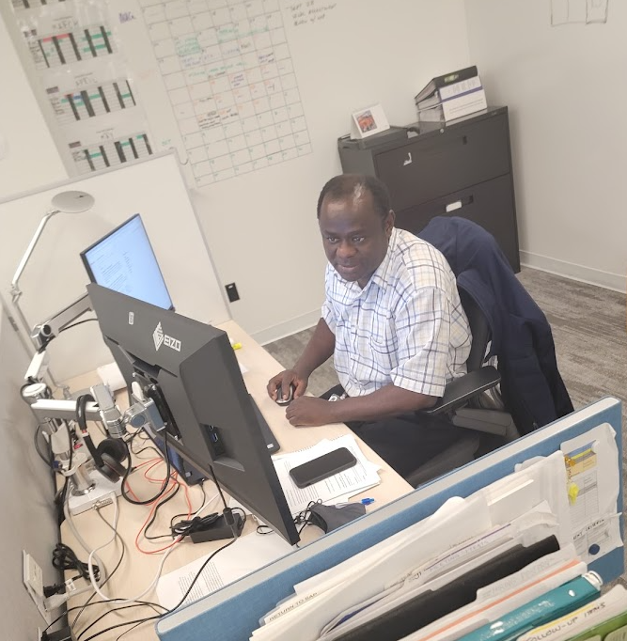
Path to P.Eng.: Navigating CBA for Internationally Experienced Professionals
Vincent Ogundare

Slide 2
Preparing for Licensure
Competency-Based Assessment:
CBA Overview: Looking at 34 important skills in 7 categories, including 8 skills in 4 categories specific to Canadian standards.
Purpose: Assesses professional competency level gained through work experience.
Requirements: Demonstrates reliable application of engineering knowledge, awareness of professional limits, and ability to seek further expertise when needed.
Goals: Ensures a fair, clear, and efficient licensure process that protects public safety.

Slide 3
Mandatory Canadian Environment Competencies
1. Technical Category
1.1. Regulations, Codes & Standards
1.6 Safety Awareness
1.9 Demonstrate Peer Review and Quality Control
2. Communication Category
2.1 Oral Communication (in English/French)
2.2 Writing (in English/French)
2.3 Reading and Comprehension (in English/French)
5. Professional Accountability
5.1 Code of Ethics
6. Social, Economic, Environmental & Sustainability
6.2 Engineering and the Public
Notes:
1. Technical Category
Skill: Regulations, Codes & Standards
Explanation: Understanding and applying local engineering standards, codes, and regulations specific to Canada.
Example in the slide
2. Safety Awareness
Explanation: Maintaining and promoting workplace and public safety through adherence to Canadian health and safety laws.
Example: "Consider a scenario where you are supervising a construction site. You must ensure all workers are following the Occupational Health and Safety Act, which might involve conducting regular safety drills and providing PPE (Personal Protective Equipment) to all workers.
3. Peer Review and Quality Control
Explanation: Engaging in systematic review processes by peers to enhance the reliability and quality of engineering projects.
Example: "In a peer review session, you may present your project plans for a new water treatment facility to fellow engineers. The session could focus on ensuring the design meets the CSA (Canadian Standards Association) standards for environmental engineering.
4. Communication Category
Skills: Oral Communication, Writing, Reading and Comprehension (in English/French)
Explanation: Effectively communicating in Canada’s official languages, tailored to professional engineering contexts.
5. Professional Accountability
Skill: Code of Ethics
Explanation: Upholding the ethical standards set by Canadian engineering bodies.
Example: "If faced with a conflict of interest in a project bidding process, adhering to Engineers Canada’s guidelines would involve disclosing your relationship with potential contractors to maintain transparency and integrity

Slide 4
Steps:
Education
Employment History
Validators
Self-assessment
Supporting Documents
Submission
Review & feedback.
Complete any additional requirement.
Pathway to Certification
Notes:
Education Verification:
Confirm education credentials with EGM.
Reach out to EGM for additional qualifications”.
Employment History:
Document comprehensive work history”.
Include all engineering and non-engineering roles”, “Mention postgraduate studies and research if applicable”.
Validators:
Identify and engage validators”.
Validators verify your competencies and skills”.
Self-Assessment:
Complete self-assessment of competencies.
Match personal skills with required competencies”.
Supporting Documents:
Prepare supporting documents”.
Project portfolios, certifications, professional references, etc.
Submission:
Submit application and documents to EGM.
Ensure all information is accurate and complete.
Review & Feedback:
EGM reviews application.
Possible request for additional information”.
Final Steps:
Complete any additional requirements”.
Receive licensure upon successful verification and assessment”.

Slide 5
Review:
Education
The education details you gave to EGM for registration are listed in this section.
If you want to include more educational qualifications, please reach out to EGM directly.

Slide 6
Sample Employment History for an Internationally Educated and Experienced Applicant
Key Points:
No gaps in the employment history.
Include 'Other / Non-Engineering experience.
Postgraduate studies, if applicable.
Research work & Thesis.
Organize the work experience history chronologically

Slide 7
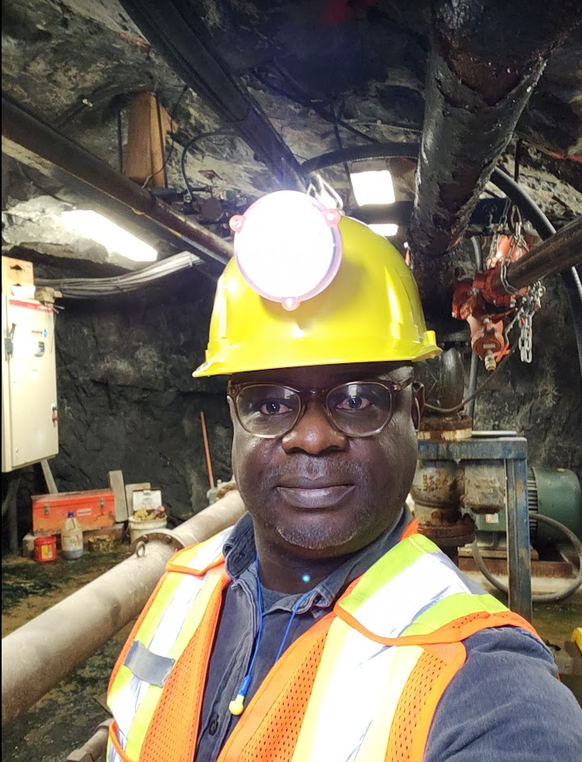
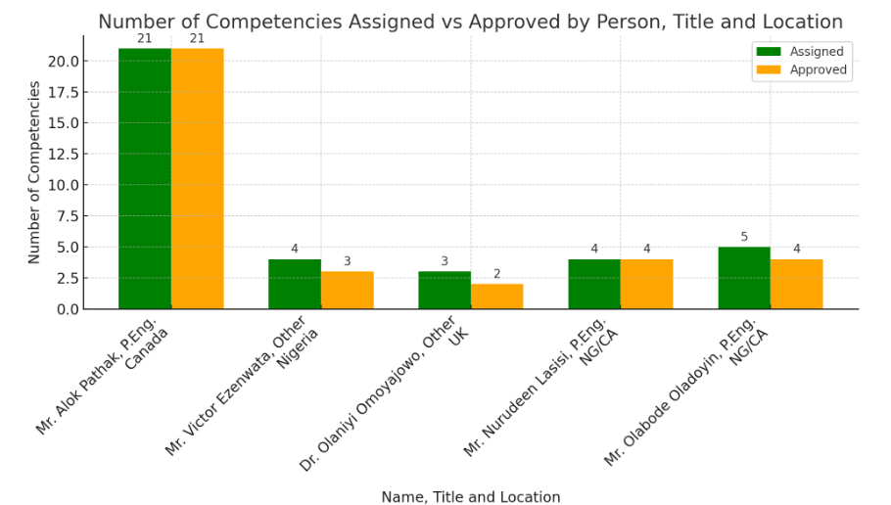
Application for International Experience with a Global Validators' Perspective
Location/ # of competencies
# of approved competencies

Slide 8
Regulations, Codes & Standards Compliance for SAP Office Renovation
Indicators:
Identify and comply with legal and regulatory requirements for project activities.
Ensure incorporation of codes and regulatory requirements in design materials
Prepare reports assessing project compliance with codes, standards, and legal/regulatory requirements.
Recognize the need to design for code compliance while achieving constructability.
Situation: Application for renovation permits for both exterior and interior improvements at an existing SAP office in Vancouver.
Action Taken:
I followed through with the Renovation - Building Permit Application process by completing all the checklists for Field Review and Tenant Improvement Applications requirements. -A
I applied for the City of Vancouver permit to execute the project and completed the associated forms like the Development Building application form and Confirmation of Commitment by Owner and Coordinating Registered Professional. -A
I ensured that all the City of Vancouver site inspections were carried out, and I prepared a report on the fire suppression system. - C
I confirmed that the alteration of the floor space does not impede the existing coverage of the sprinkler system that was installed according to the requirements of NFPA 13-2013 and the Vancouver Building By-Law. - D
I calculated the heat load and specified the heat pump referencing ASHRAE/IES Standard 90.1-2016, which was reviewed by my supervisor. B
As part of the permit process, I completed the City of Vancouver compliance form for the HVAC System. The form was completed in line with ASHRAE/IES Standard 90.1-2016, Section 6.4. - A
I engaged other professionals, i.e., Structural, Plumbing, Mechanical, Electrical, Fire Suppression (air/hood only), to complete Schedule B (Assurance of Professional Design for Field Review). A
Outcome:
Field review approved in just 5 weeks, faster than the usual 7-9 weeks.
All building inspections by the City of Vancouver passed on the first attempt.

Slide 9
SUPPORTING DOCUMENTS
Examples:
Project Portfolios: Design, blueprint, report, and case study collections.
Professional References: Endorsement letters highlighting skills and experience.
Certifications: Engineering licenses and relevant certificates.
Continuing Education: Records of professional courses or workshops.
Performance Reviews: Employer evaluations.
Intellectual Property: Lists of patents and published articles.
Awards: Professional accolades.
Work Samples: Demonstrations of technical and project management expertise.
Peer Review: Design review, Technical peer review, standard review like SOP & Walkthrough and inspection etc.

Slide 10
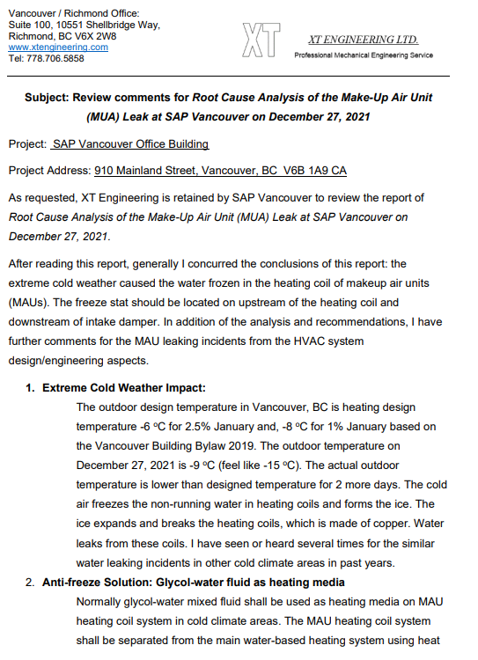
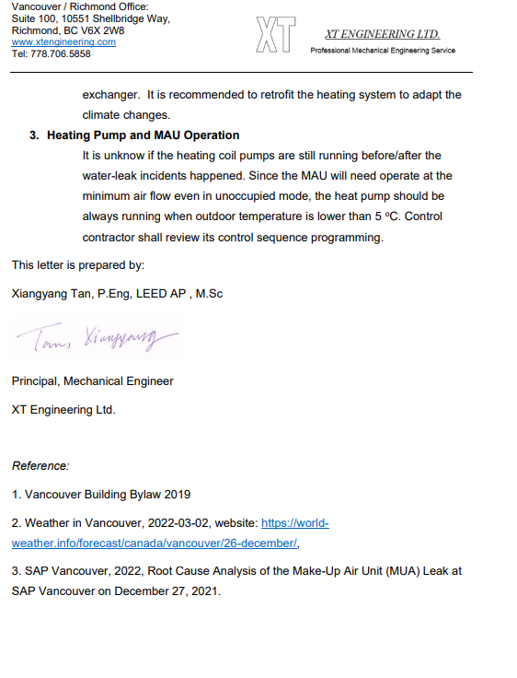
Practical - Peer Review / Work Sample

Slide 11
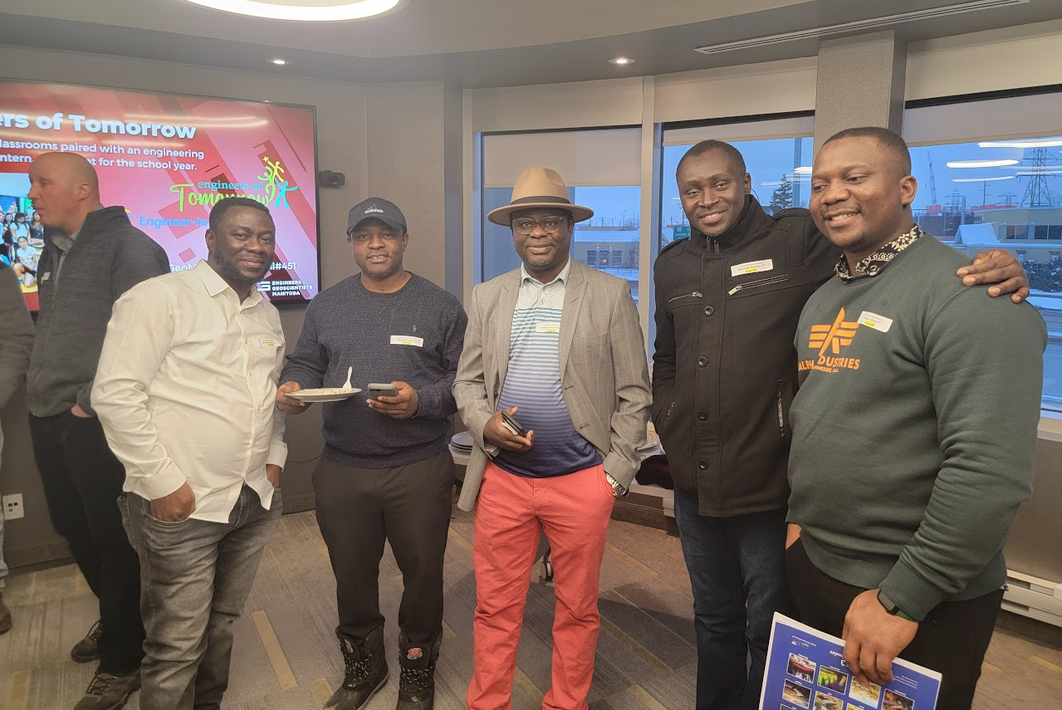
Thank You

